Slide 1

Programming in Java
Topic: Collection Framework
By
Ravi Kant Sahu
Asst. Professor, LPU

Slide 2
Contents
Introduction
List: ArrayList
Set: TreeSet
Map: HashMap
Deque
Ordering Collections: Comparable and Comparator
Ravi Kant Sahu, Asst. Professor @ Lovely Professional University, Punjab (India)

Slide 3
Introduction
A collection is simply an object that groups multiple elements into a single unit.
Collections are used to store, retrieve, manipulate, and communicate aggregate data.
java.util package contains all the collection classes and interfaces.
Ravi Kant Sahu, Asst. Professor @ Lovely Professional University, Punjab (India)

Slide 4
Collection Framework
A collections framework is a unified architecture for representing and manipulating collections.
It is a collection of classes and interfaces.
At the top of collection framework hierarchy, there is an interface, Collection.
Ravi Kant Sahu, Asst. Professor @ Lovely Professional University, Punjab (India)

Slide 5
Advantages of Collections
Reduces programming effort
Increases program speed and quality
Allows interoperability among unrelated APIs
Ravi Kant Sahu, Asst. Professor @ Lovely Professional University, Punjab (India)

Slide 6
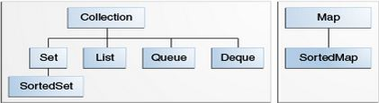
Collection Interfaces
The Java Collections Framework supports two types of containers:
Collection: for storing a collection of elements
Map: for storing key/value pairs
Ravi Kant Sahu, Asst. Professor @ Lovely Professional University, Punjab (India)

Slide 7
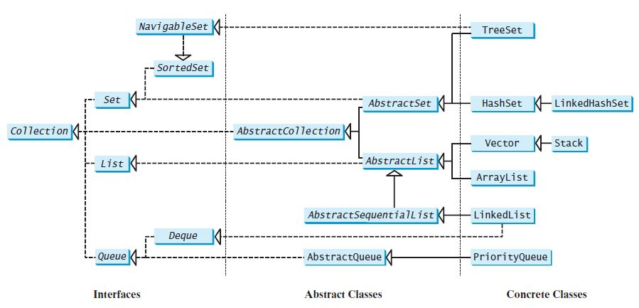

Slide 8
Collection Interfaces
Sets store a group of non-duplicate elements.
Lists store an ordered collection of elements.
Queues store objects that are processed in first-in, first-out fashion.
Maps are efficient data structures for quickly searching an element using a key.
Ravi Kant Sahu, Asst. Professor @ Lovely Professional University, Punjab (India)

Slide 9
The AbstractCollection class provides partial implementation for the Collection interface.
It implements all the methods in Collection except the size() and iterator() methods.
Ravi Kant Sahu, Asst. Professor @ Lovely Professional University, Punjab (India)

Slide 10
Collection
Interface
Ravi Kant Sahu, Asst. Professor @ Lovely Professional University, Punjab (India)

Slide 11
Methods of Collection Interface
boolean add(Object o)
Appends the specified element o to the end of the collection.
boolean addAll(Collection c )
Appends all of the elements in the specified collection to the end of the collection.
Ravi Kant Sahu, Asst. Professor @ Lovely Professional University, Punjab (India)

Slide 12
boolean contains(Object o)
Returns true if this list contains the specified element.
boolean containsAll(Collection c)
Returns true if this collection contains all the elements in c.
Ravi Kant Sahu, Asst. Professor @ Lovely Professional University, Punjab (India)

Slide 13
boolean remove(Object o)
Removes the object from this collection.
boolean removeAll(Collection c)
Removes all the elements in c from this collection.
boolean retainAll(Collection c)
Retains the elements that are both in c and in this collection.
Ravi Kant Sahu, Asst. Professor @ Lovely Professional University, Punjab (India)

Slide 14
void clear()
Removes all of the elements from the collection.
boolean isEmpty()
Returns true if this collection contains no elements.
int size()
Returns the number of elements in the collection.
Ravi Kant Sahu, Asst. Professor @ Lovely Professional University, Punjab (India)

Slide 15
Object [] toArray()
Returns an array of Object for the elements in the collection.
int hashCode()
Returns the hash code for the collection.
Iterator iterator()
Returns the iterator object for the invoking collection.
        I
Ravi Kant Sahu, Asst. Professor @ Lovely Professional University, Punjab (India)

Slide 16
Practice MCQs
Which interface restricts duplicate elements?
Set
List
Map
All of these
Which does NOT inherit the Collection interface?
List
Map
Set
None of these
Ravi Kant Sahu, Asst. Professor @ Lovely Professional University, Punjab (India)

Slide 17
Practice MCQs
Deque and Queue are derived from:
A. AbstractList
B. Collection
C. AbstractCollection
D. List
The root interface of Java Collection framework hierarchy is -
A. Collection
B. List
C. Collections
D. Set
Ravi Kant Sahu, Asst. Professor @ Lovely Professional University, Punjab (India)

Slide 18
Practice MCQs
LinkedList class implements?
A.Deque
B.List
C.Both A and B
D.None of these
Ravi Kant Sahu, Asst. Professor @ Lovely Professional University, Punjab (India)

Slide 19
Iterators
Ravi Kant Sahu, Asst. Professor @ Lovely Professional University, Punjab (India)

Slide 20
Iterator
There is an Iterable interface at the top of Collection hierarchy.
The Collection interface extends the java.lang.Iterable interface.
It defines a method which returns an Iterator object for the elements of Collection.
Iterator iterator()
Iterator object is used to traverse the elements in a collection.
Ravi Kant Sahu, Asst. Professor @ Lovely Professional University, Punjab (India)

Slide 21
Methods of Iterator Interface
boolean hasNext()
Returns true if this iterator has more elements to traverse.
Object next()
Returns the next element from this iterator.
void remove()
Removes the last element obtained using the next method.
Ravi Kant Sahu, Asst. Professor @ Lovely Professional University, Punjab (India)

Slide 22
ListIterator
Ravi Kant Sahu, Asst. Professor @ Lovely Professional University, Punjab (India)

Slide 23
ListIterator
ListIterator is derived from Iterator interface and comes with more methods than Iterator.
ListIterator can be used to traverse for List type Objects.
Allows to traverse in both the directions.
Ravi Kant Sahu, Asst. Professor @ Lovely Professional University, Punjab (India)

Slide 24
ListIterator
A ListIterator has no current element; its cursor position always lies between the element that would be returned by a call to previous() and the element that would be returned by a call to next().
The remove() and set(Object) methods are not defined in terms of the cursor position; they are defined to operate on the last element returned by a call to next() or previous().
Ravi Kant Sahu, Asst. Professor @ Lovely Professional University, Punjab (India)

Slide 25
ListIterator Methods
public abstract boolean hasPrevious()
public abstract Object previous();
public abstract int nextIndex();
public abstract int previousIndex();
public abstract void set(Object);
public abstract void add(Object);
Ravi Kant Sahu, Asst. Professor @ Lovely Professional University, Punjab (India)

Slide 26
list Interface
Ravi Kant Sahu, Asst. Professor @ Lovely Professional University, Punjab (India)

Slide 27
List
The List interface extends the Collection interface.
It defines a collection for storing elements in a sequential order.
It define an ordered collection with duplicates allowed.
ArrayList , Vector and LinkedList are the sub-classes of List interface.
Ravi Kant Sahu, Asst. Professor @ Lovely Professional University, Punjab (India)

Slide 28
Methods of List Interface
boolean add(int index, Object o )
boolean addAll(int index, Collection c )
Object remove(int index)
Object get(int index)
Object set(int index, Object o)
int indexOf(Object o)
int lastIndexOf(Object o)
ListIterator listIterator()
ListIterator listIterator(int start_index)
List subList(int start_index, int end_index): returns a sublist from start_index to end_index-1
Ravi Kant Sahu, Asst. Professor @ Lovely Professional University, Punjab (India)

Slide 29
Sub-classes of List
ArrayList
LinkedList
Vector
Stack
Ravi Kant Sahu, Asst. Professor @ Lovely Professional University, Punjab (India)

Slide 30
ArrayList
Ravi Kant Sahu, Asst. Professor @ Lovely Professional University, Punjab (India)

Slide 31
ArrayList
The ArrayList class extends AbstractList and implements the List interface.
Defined in java.util package.
ArrayList supports dynamic arrays that can grow as needed.
Array lists are created with an initial size.
When this size is exceeded, the collection is automatically enlarged.
When objects are removed, the array may be shrunk.
Ravi Kant Sahu, Asst. Professor @ Lovely Professional University, Punjab (India)

Slide 32
ArrayList Constructors
T he ArrayList class supports three constructors.
ArrayList() : creates an empty array list with an initial capacity sufficient to hold 10 elements.
ArrayList(int capacity) : creates an array list that has the specified initial capacity.
ArrayList(Collection c) : creates an array list that is initialized with the elements of the collection c.
Ravi Kant Sahu, Asst. Professor @ Lovely Professional University, Punjab (India)

Slide 33
Methods of ArrayList
boolean add(Object o)
Appends the specified element to the end of this list.
void add(int index, Object element)
Inserts the specified element at the specified position index in this list.
Throws IndexOutOfBoundsException if the specified index is out of range.
Ravi Kant Sahu, Asst. Professor @ Lovely Professional University, Punjab (India)

Slide 34
boolean addAll(Collection c )
Appends all of the elements in the specified collection to the end of this list.
Throws NullPointerException if the specified collection is null.
boolean addAll(int index, Collection c )
Inserts all of the elements of the specified collection into this list, starting at the specified position.
Throws NullPointerException if the specified collection is null.
Ravi Kant Sahu, Asst. Professor @ Lovely Professional University, Punjab (India)

Slide 35
Object remove(int index)
Removes the element at the specified position in this list.
Object remove(Object o)
Removes the element o from this list.
Object clone()
Returns a shallow copy of this ArrayList.
int size()
Returns the number of elements in the list.
void clear()
Removes all of the elements from this list.
Ravi Kant Sahu, Asst. Professor @ Lovely Professional University, Punjab (India)

Slide 36
boolean contains(Object o)
Returns true if this list contains the specified element.
Object get(int index)
Returns the element at the specified position in this list.
int indexOf(Object o)
Returns the index in this list of the first occurrence of the specified element, or -1 if the List does not contain the element.
int lastIndexOf(Object o)
Returns the index in this list of the last occurrence of the specified element, or -1.
Ravi Kant Sahu, Asst. Professor @ Lovely Professional University, Punjab (India)

Slide 37
void ensureCapacity(int minCapacity)
Increases the capacity of this ArrayList instance, if necessary, to ensure that it can hold at least the number of elements specified by the minimum capacity argument.
Object set(int index, Object element)
Replaces the element at the specified position in this list with the specified element.
Throws IndexOutOfBoundsException if the specified index is out of range (index < 0 || index >= size()).
Ravi Kant Sahu, Asst. Professor @ Lovely Professional University, Punjab (India)

Slide 38
void trimToSize()
Trims the capacity of this ArrayList instance to be the list’s current size.
Ravi Kant Sahu, Asst. Professor @ Lovely Professional University, Punjab (India)

Slide 39
Set Interface
Ravi Kant Sahu, Asst. Professor @ Lovely Professional University, Punjab (India)

Slide 40
Set Interface
A set is an efficient data structure for storing and processing non-duplicate elements.
Set does not introduce new methods or constants.
The sub-classes of Set (HashSet, TreeSet & LinkedHashSet) ensure that no duplicate elements can be added to the set.
Ravi Kant Sahu, Asst. Professor @ Lovely Professional University, Punjab (India)

Slide 41
Set Interface
The AbstractSet class provides implementations for the equals() method and the hashCode().
The hash code of a set is the sum of the hash codes of all the elements in the set.
The size() and iterator() are not implemented in the AbstractSet class.
Ravi Kant Sahu, Asst. Professor @ Lovely Professional University, Punjab (India)

Slide 42
TREESet
Ravi Kant Sahu, Asst. Professor @ Lovely Professional University, Punjab (India)

Slide 43
TreeSet
TreeSet implements the NavigableSet interface.
We can add objects into a tree set as long as they can be compared with each other.
Access and retrieval times are quite fast.
Ravi Kant Sahu, Asst. Professor @ Lovely Professional University, Punjab (India)

Slide 44
TreeSet
Constructor:
TreeSet()
TreeSet(Collection c)
TreeSet(Comparator c)
Ravi Kant Sahu, Asst. Professor @ Lovely Professional University, Punjab (India)

Slide 45
Comparator Interface
java.util.Comparator interface provides two abstract methods:
public interface Comparator<T>
{
public abstract int compare(T ob1, T ob2);
public abstract boolean equals(java.lang.Object);
…
}
Ravi Kant Sahu, Asst. Professor @ Lovely Professional University, Punjab (India)

Slide 46
Comparable Interface
java.lang.Comparable interface provides only one abstract method:
public interface Comparable<T>
{
public abstract int compareTo(T ob);
}
Ravi Kant Sahu, Asst. Professor @ Lovely Professional University, Punjab (India)

Slide 47
Implementing TreeSet
import java.util.*;
public class SortSetExample {
public static void main(String...rk){
Set<Integer> tree = new TreeSet<Integer>();
tree.add(3);
tree.add(1);
tree.add(2);
System.out.println("treeSet : "+treeSet);
}
}
Ravi Kant Sahu, Asst. Professor @ Lovely Professional University, Punjab (India)

Slide 48
Implementing TreeSet with Comparator sorting in descending order
import java.util.*;
public class SortSetExample {
public static void main(String...rk){
Set<Integer> tree = new TreeSet<Integer>(new Comparator<Integer>() {
public int compare(Integer o1, Integer o2) {
return o2.compareTo(o1);
}
});
tree.add(3); tree.add(1); tree.add(2);
System.out.println("treeSet : "+tree);
}
}
Ravi Kant Sahu, Asst. Professor @ Lovely Professional University, Punjab (India)

Slide 49
Implementing TreeSet with Custom Objects using Comparator
class Employee{
String name;
String id;
public Employee(String name, String id) {
this.name = name; this.id = id;
}
public String toString() {
return "Employee{" + "name=" + name + ", id=" + id + '}';
}
}
Ravi Kant Sahu, Asst. Professor @ Lovely Professional University, Punjab (India)

Slide 50
Implementing TreeSet with Custom Objects using Comparator
public class SortSetExample {
public static void main(String...a){
Employee emp1=new Employee("sam","4");
Employee emp2=new Employee("amy","2");
Employee emp3=new Employee("brad","1");
Set<Employee> treeSet = new TreeSet<Employee>(new Comparator<Employee>() {
public int compare(Employee o1, Employee o2) { return o1.name.compareTo(o2.name); }
});
treeSet.add(emp1); treeSet.add(emp2); treeSet.add(emp3);
System.out.println("treeSet : "+treeSet);
}}
Ravi Kant Sahu, Asst. Professor @ Lovely Professional University, Punjab (India)

Slide 51
DEQueue
Ravi Kant Sahu, Asst. Professor @ Lovely Professional University, Punjab (India)

Slide 52
Deque Interface
Deque supports element insertion and removal at both ends.
The name deque is short for “double-ended queue” and is usually pronounced “deck.”
The Deque interface extends Queue with additional methods for inserting and removing elements from both ends of the queue.
The methods addFirst(e), removeFirst(), addLast(e), removeLast(), getFirst(), and getLast() are defined in the Deque interface.
Ravi Kant Sahu, Asst. Professor @ Lovely Professional University, Punjab (India)

Slide 53
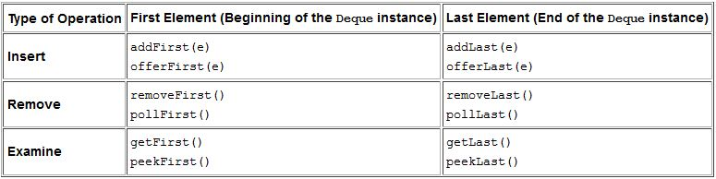
Deque Methods
Ravi Kant Sahu, Asst. Professor @ Lovely Professional University, Punjab (India)

Slide 54
Insert Methods
The addfirst and offerFirst methods insert elements at the beginning of the Deque instance.
The methods addLast and offerLast insert elements at the end of the Deque instance.
When the capacity of the Deque instance is restricted, the preferred methods are offerFirst and offerLast because addFirst might fail to throw an exception if it is full.
Ravi Kant Sahu, Asst. Professor @ Lovely Professional University, Punjab (India)

Slide 55
Remove Methods
removeFirst and pollFirst methods remove elements from the beginning of the Deque.
The removeLast and pollLast methods remove elements from the end.
The methods pollFirst and pollLast return null if the Deque is empty whereas the methods removeFirst and removeLast throw NoSuchElementException if the Deque instance is empty.
Ravi Kant Sahu, Asst. Professor @ Lovely Professional University, Punjab (India)

Slide 56
Retrieve Methods
getFirst and peekFirst retrieve the first element but don’t remove the value from the Deque.
Similarly, getLast and peekLast retrieve the last element.
The methods getFirst and getLast throw an exception if the deque instance is empty whereas the methods peekFirst and peekLast return NULL.
Ravi Kant Sahu, Asst. Professor @ Lovely Professional University, Punjab (India)

Slide 57
Deque Implementation
The ArrayDeque class is the resizable array implementation of the Deque interface, whereas the LinkedList class is the list implementation.
The LinkedList is more flexible than the ArrayDeque as null elements are allowed in the LinkedList implementation but not in ArrayDeque.
ArrayDeque is more efficient than the LinkedList for add and remove operation at both ends.
The best operation in a LinkedList implementation is removing the current element during the iteration.
Ravi Kant Sahu, Asst. Professor @ Lovely Professional University, Punjab (India)

Slide 58
ArrayDeque Constructors
ArrayDeque()
Constructs an empty array deque with an initial capacity sufficient to hold 16 elements.
ArrayDeque(Collection<? extends E> c)
Constructs a deque containing the elements of the specified collection, in the order they are returned by the collection's iterator.
ArrayDeque(int numElements)
Constructs an empty array deque with an initial capacity sufficient to hold the specified number of elements.
Ravi Kant Sahu, Asst. Professor @ Lovely Professional University, Punjab (India)

Slide 59
LinkedList Constructors
LinkedList()
Constructs an empty LinkedList.
LinkedList(Collection<? extends E> c)
Constructs a list containing the elements of the specified collection, in the order they are returned by the collection's iterator.
Ravi Kant Sahu, Asst. Professor @ Lovely Professional University, Punjab (India)

Slide 60
MAP Interface
Ravi Kant Sahu, Asst. Professor @ Lovely Professional University, Punjab (India)

Slide 61
MAP Interface
A map is a container object that stores a collection of key/value pairs.
Keys are like indexes in List but in Map, the keys can be any objects.
A map cannot contain duplicate keys.
Each key maps to one value.
A key and its corresponding value form an entry stored in a map.
Ravi Kant Sahu, Asst. Professor @ Lovely Professional University, Punjab (India)

Slide 62
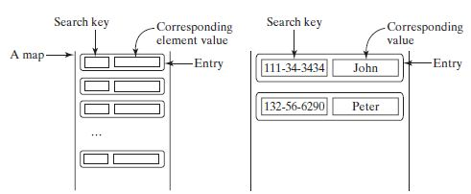
MAP
Ravi Kant Sahu, Asst. Professor @ Lovely Professional University, Punjab (India)

Slide 63
MAP Methods
int size()
void clear()
boolean isEmpty()
V put( K key, V value)
void putAll( m: Map<? extends K,? extendsV>)
boolean containsKey (Object key)
boolean containsValue(Object value)
V get(Object key)
Set<K> keySet()
V remove( Object key)
Collection <V> values()
Set<Map.Entry<K,V>> entrySet()
Ravi Kant Sahu, Asst. Professor @ Lovely Professional University, Punjab (India)

Slide 64
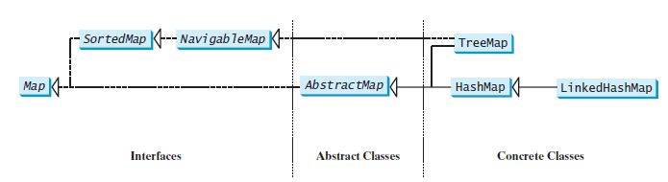
MAP Class Hierarchy
Ravi Kant Sahu, Asst. Professor @ Lovely Professional University, Punjab (India)

Slide 65
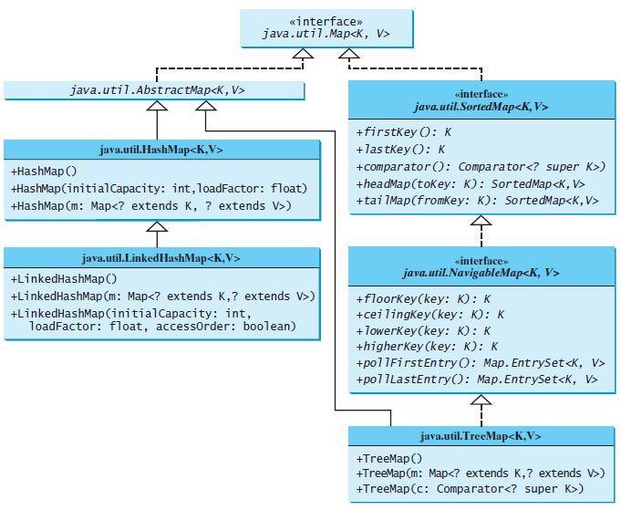
MAP
Ravi Kant Sahu, Asst. Professor @ Lovely Professional University, Punjab (India)

Slide 66
HashMap
The HashMap class is efficient for locating a value, inserting an entry, and deleting an entry.
The entries in a HashMap are not ordered.
public class HashMap<K, V> extends AbstractMap<K, V> implements Map<K, V>, Cloneable, Serializable
Ravi Kant Sahu, Asst. Professor @ Lovely Professional University, Punjab (India)

Slide 67
HashMap
Constructors:
HashMap()
Constructs an empty HashMap with the default initial capacity (16) and the default load factor (0.75).
HashMap(int initialCapacity)
Constructs an empty HashMap with the specified initial capacity and the default load factor (0.75).
HashMap(int initialCapacity, float loadFactor)
Constructs an empty HashMap with the specified initial capacity and load factor.
HashMap(Map<? extends K,? extends V> m)
Constructs a new HashMap with the same mappings as the specified Map.
Ravi Kant Sahu, Asst. Professor @ Lovely Professional University, Punjab (India)

Slide 68
Let’s Do It?
Given an array containing Integers.
WAP using appropriate collection to find out the numbers which occur exactly N times.
Example: arr = {1, 3, 4, 3, 1, 1, 2, 3, 2, 4, 5};
N = 2;
Output: 4, 2
Ravi Kant Sahu, Asst. Professor @ Lovely Professional University, Punjab (India)

Slide 69
Let’s Do It?
WAP to implement a method which accepts an arraylist containing duplicate values and returns a Collection having unique elements only.
public Collection revoveDuplicate(ArrayList<T extends Number> al)
Ravi Kant Sahu, Asst. Professor @ Lovely Professional University, Punjab (India)

Slide 70
Let’s Do It?
WAP to create a class Student with attributes name and cgpa. Add at least 5 Student objects in an appropriate collection such that they are sorted in descending order on the basis of their cgpa.
Display the names of all the students who are eligible for Verizon placement drive. (Eligibility: cgpa >=7.5 )
Ravi Kant Sahu, Asst. Professor @ Lovely Professional University, Punjab (India)

Slide 71
Let’s Do It?
WAP to create a class Student with attributes name roll_no and cgpa. Add at least 5 Student objects in an appropriate collection such that they can be efficiently searched using the roll number as the key.
Display the names of all the students who are eligible for Verizon placement drive. (Eligibility: cgpa >=7.5 )
Ravi Kant Sahu, Asst. Professor @ Lovely Professional University, Punjab (India)

Slide 72
Let’s Do It?
WAP to create a class Car with private attributes name, mileage and price and a parameterized constructor to initialize them. Provide the getter methods for obtaining the individual attribute values.
Create 5 Car objects and store them in a collection such that the Car with best mileage can be figured out with a given price range.
Prompt the user to enter the amount within which he wants to buy the car. Display all the options available with him along with the mileage in descending order.
Ravi Kant Sahu, Asst. Professor @ Lovely Professional University, Punjab (India)

Slide 73
Let’s Do It?
Given a class Employee with attributes name and salary.
Use an appropriate collection such that when a user enters the salary, it must display all the employees with given salary.
Ravi Kant Sahu, Asst. Professor @ Lovely Professional University, Punjab (India)

Slide 74


